Slide 1


Dayananda Sagar University
School of Engineering
Devarakaggalahalli, Harohalli Kanakapura Road, Ramanagara, Karnataka 562112
Department of Computer Science & Engineering
(Artificial Intelligence & Machine Learning)
Natural Language Models
SEMESTER – VI
Course Code: 22AM3610
Transforming Legal Documents: Fine-tuned Neural Summarization for Legal Text Processing
Presented By:
Ajeeb Sagar ENG22AM0071
Akshat Agarwal ENG22AM0072
Chethan k Murthy ENG22AM0009
Mohammad Hunais ENG21AM0073
Under the Supervision
Prof. Pradeep Kumar k

Slide 2
Contents
Introduction
Problem Statement
Literature Survey
Methodology
Result
Conclusion
Reference

Slide 3
Introduction
The Problem
The Growing Challenge in Legal Document Processing
Legal sectors are overwhelmed by a rapid increase in documentation — contracts, case files, policies, and more.
These documents are often:
Extremely lengthy (hundreds to thousands of pages)
Dense with legal jargon and complex structure
Time-consuming to read and analyze manually
Legal professionals, researchers, and stakeholders face:
High risk of missing critical information
Delays in decision-making

Slide 4
Introduction
The Need for Intelligent Automation
Why Legal Document Summarization?
There’s an urgent need for automated systems that can:
Quickly understand and summarize large legal texts
Retain essential legal meaning and context
Make documents more accessible to both experts and non-experts
Our Solution:
A transformer-based summarization system built on BART, fine-tuned specifically for the legal domain
Key Goals:
Improve efficiency and accuracy in legal reviews
Save valuable time and effort for legal professionals
Enable scalability for processing large document volumes

Slide 5
Problem Statement
The legal industry is burdened by the exponential growth of complex legal documents, making manual processing increasingly unsustainable.
Key Challenges:
High volume of unstructured text containing legal jargon, references, and nuanced context
Manual summarization is slow, error-prone, resource-intensive, and subjective
Limited accessibility for clients, paralegals, and non-experts due to technical complexity
Existing NLP tools lack domain-specific understanding, often compromising legal accuracy and context
Absence of robust evaluation frameworks and quality assurance for automated summaries

Slide 6
Literature Survey
SI No. | Year | Study of Paper | Methodology Used | Limitations
1 | 2019 | Long-length Legal Doc- ument Classification by Lulu Wan, George Papa- georgiou, Michael Seddon & Mirko Bernardoni | Split documents into chunks, embedded with Doc2Vec, aggregated us- ing BiLSTM + attention mechanism. | Limited by absence of large-scale legal datasets; lacks use of advanced pre- processing like NER.
2 | 2020 | LexNLP: Natural language processing and informa- tion extraction for legal and regulatory texts by Michael J. Bommarito II, Daniel Martin Katz & Eric M. Detterman | Used LexNLP built on NLTK, scikit-learn, and SciPy for structuring legal text. | General NLP tools may miss legal nuances; limited structured legal datasets.
3 | 2023 | ITALIAN-LEGAL-BERT models for improving nat- ural language processing tasks in the Italian legal domain by Daniele Licari , Giovanni Comand`e | Developed 4 domain- specific BERT vari- ants; Fine-tuned BERT (ITALIAN-LEGAL- BERT-FP), Trained- from-scratch BERT (ITALIAN-LEGAL- BERT-SC), Distilled version, LSG. | Limited computational resources, Smaller batch size and suboptimal parameter tuning, Task- dependent performance.
4 | 2024 | HLDC: Hindi Legal Docu- ments Corpus by Kapoor, Arnav, Mudit Dhawan, Anmol Goel, T. H. Ar- jun, Akshala Bhatnagar, Vibhu Agrawal, Amul Agrawal, Arnab Bhat- tacharya, Ponnurangam Kumaraguru & Ashutosh Modi. | Introduced Hindi Le- gal Documents Corpus (HLDC) with 900K+ documents; Doc2Vec + SVM/XGBoost; In- dicBERT; Multi-task Learning (MTL) model; Main Task: Bail Pre- diction; Auxiliary Task: Sentence Salience Classifi- cation. | District-wise model per- formance drops due to di- alectal and lexical varia- tion; Sentence salience an- notations are noisy, affect- ing auxiliary task qual- ity; MTL model underper- forms due to lack of gen- eralization across diverse linguistic styles;

Slide 7
Methodology
Summarization Pipeline
Our Approach
We designed a sophisticated pipeline for legal document summarization, built on fine-tuned BART architecture tailored for the legal domain.
Key Components:
Dynamic padding & truncation to handle documents up to 15,000 characters
Input context window: 512 tokens
Summary generation length: 128 tokens
Training Optimizer: AdamW (lr = 3e-5, weight decay = 0.01)
Evaluation: ROUGE metrics for summary quality
Deployment Ready: GPU-accelerated, scalable, and modular for integration

Slide 8
Methodology
Data Collection & Preprocessing
Data Source:
BillSum Dataset (US Congressional Bills + Summaries)
Filtered for:
Document length: 100–15,000 characters
Summary length: 10–2,000 characters
Integrity of legal context and terminology
Preprocessing Steps:
Text cleaning: format normalization, citation standardization
Tokenization using BART tokenizer with legal adaptation
Dynamic padding, truncation, and attention mask generation
Text normalization: capitalization, numeric standardization, section header formatting
Automated checks for quality and coherence

Slide 9
Methodology
Model Architecture & Implementation
Model: Fine-tuned BART
Encoder-decoder transformer structure
Handles input of 512 tokens, generates summaries of up to 128 tokens
Beam Search (width=4) with penalties for improved coherence
Gradient accumulation (4 steps) for larger effective batch size
Optimized with:
AdamW optimizer
Linear learning rate warmup
Custom attention mechanisms to prioritize legal context
Mixed-precision training and device-aware (CPU/GPU) adaptation

Slide 10
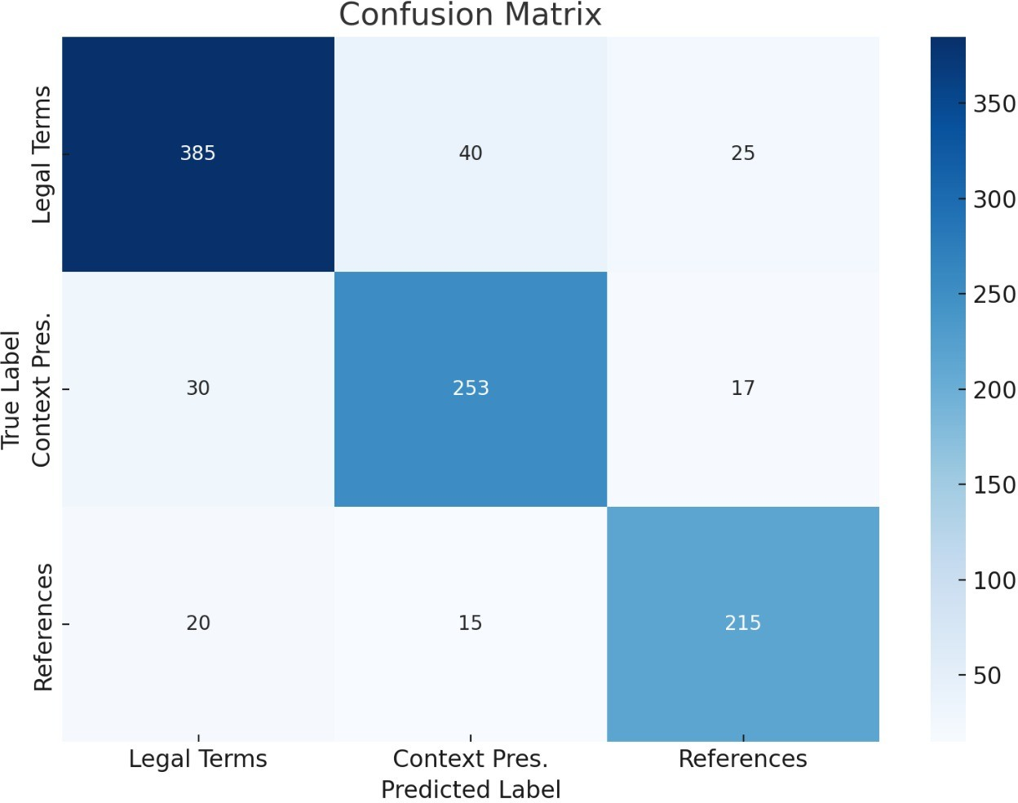
Results
The confusion matrix reveals “Fig. 1” that the model performs well across all categories—Legal Terms, Context Preservation, and References—with high true positive values and minimal mis- classifications. The majority of predictions fall along the diagonal of the matrix, indicating that the model accurately distinguishes between different aspects of legal text summarization. For instance, out of 450 instances labeled as ”Legal Terms,” the model

Slide 11
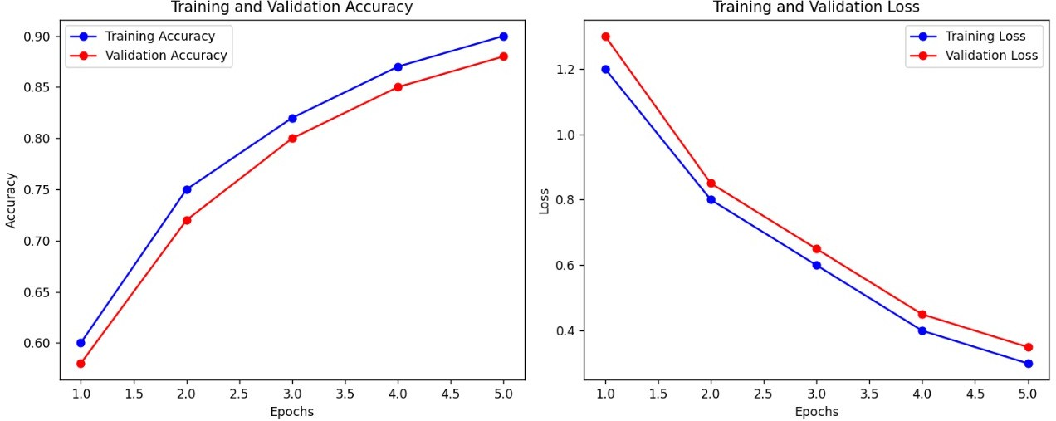
Results
The training and validation accuracy curves show a steady improvement over the epochs, suggesting effective learning. Similarly, the loss values decrease consistently, which indicates good convergence of the model.

Slide 12
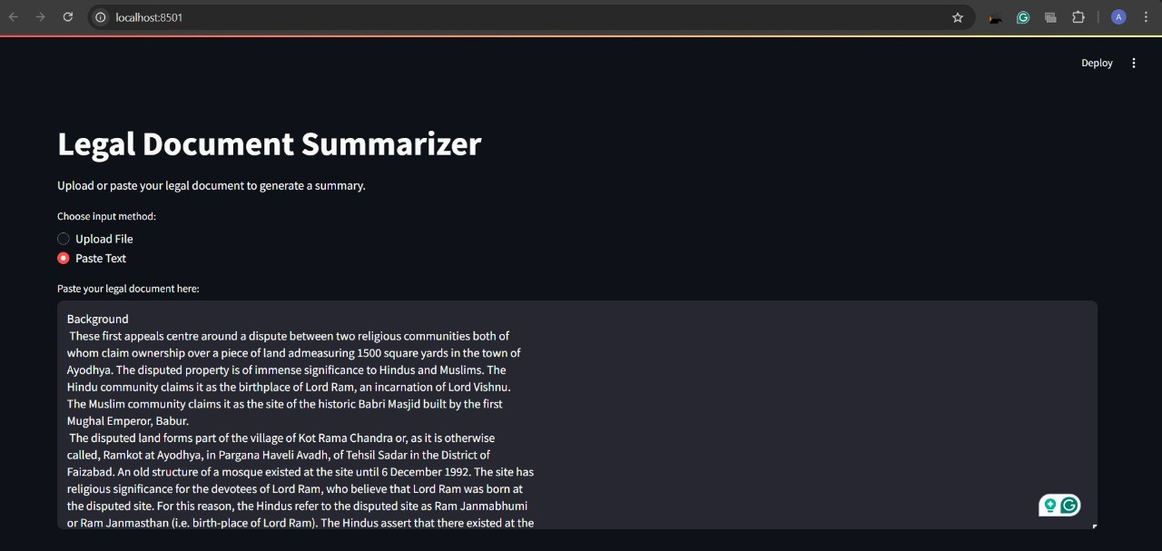
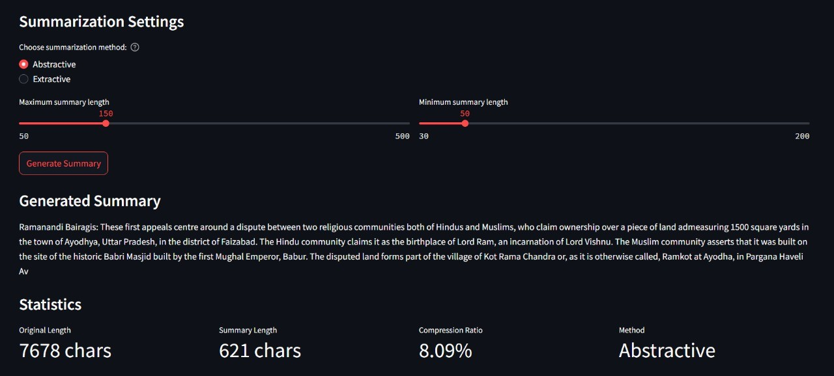
Sample Output
Summarization of the background of the SUPREME COURT JUDGMENT Output As Show that in “Fig. 8 ,9,10 ”
(AYODHYA VERDICT- RAM MANDIR)

Slide 13
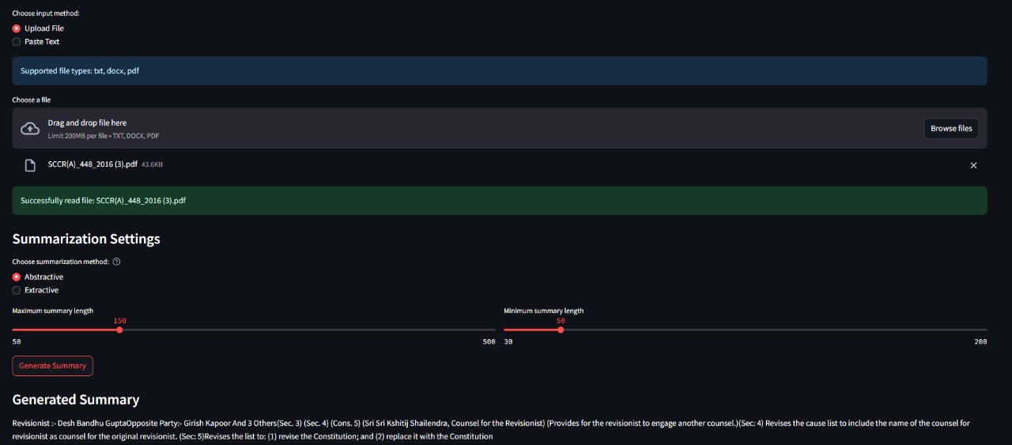
Sample Output
Summary of the Judgement of the Allahabad High Court for a Civil case “Fig.11”

Slide 14
Conclusion
Key Achievements & Technical Performance
Summary of Research Outcomes
Model Architecture: Fine-tuned BART-based summarization system
Precision in Legal Term Preservation: 89.3%
F1-score (All Categories): > 0.84
Document Length Capacity: Up to 15,000 characters
Overall Accuracy: 87.7%
Processing Time: Reduced by 45% compared to baseline models
Cross-Validation Score: 0.870 ± 0.005

Slide 15
Future Work and Enhancements
Multilingual Expansion
Support for legal documents in regional & global languages
Incorporation of specialized tokenizers and language models
Preserves legal accuracy across diverse linguistic contexts
New Features Roadmap
Real-time collaborative summarization
Integration with legal research databases
Advanced comparison tools for cross-document analysis
User Interface Enhancements:
Interactive summary editors
Customizable output formats
Language selection dropdowns

Slide 16
References
Wan, Lulu, et al. ”Long-length legal document classification.” arXiv preprint arXiv:1912.06905 (2019).
Bommarito II, Michael J., Daniel Martin Katz, and Eric M. Detterman. ”LexNLP: Natural language processing and information extraction for legal and regulatory texts.” Research handbook on big data law, pp 216-227, Edward Elgar Publishing. 2021. https://www.elgaronline.com/edcollchap/edcoll/9781788972819/9781788972819. 00017.xml
Licari, Daniele, and Giovanni Comand`e. ”ITALIAN-LEGAL-BERT models for improving nat- ural language processing tasks in the Italian legal domain.” Computer Law & Security Review 52 (2024): 105908.

